Slide 1
SERVER I
SLIDE: 2

Slide 2
Group Presentations

Slide 3
SERVER I
Lesson Plan
Day 3:
■■ Objective 2.1: Configure file and share access
■■ Objective 2.2: Configure print and document services
■■ Objective 2.3: Configure servers for remote management
Task 3

Slide 4
SERVER I
Objective 2.1: Configure file and share access
Create and configure shares (Group A)
■■ Configure share permissions
■■ Configure offline files
■■ Configure NTFS permissions
■■ Configure access-based enumeration (ABE)
■■ Configure Volume Shadow Copy Service (VSS)
■■ Configure NTFS quotas
■■ Create and configure Work Folders

Slide 5
SERVER I
Objective 2.2: Configure print and document services (Group B)
■■ Configure the Easy Print print driver
■■ Configure Enterprise Print Management
■■ Configure drivers
■■ Configure printer pooling
■■ Configure print priorities
■■ Configure printer permissions

Slide 6
SERVER I
Objective 2.3: Configure servers for remote
Management (Group C)
■■ Configure WinRM
■■ Configure down-level server management
■■ Configure servers for day-to-day management tasks
■■ Configure multiserver management
■■ Configure Server Core
■■ Configure Windows Firewall
■■ Manage non-domain joined servers

Slide 7
SERVER I
NTFS vs. Share Permissions

Slide 8
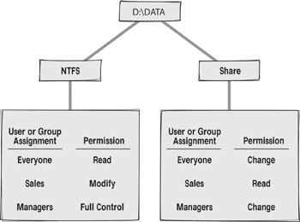
SERVER I

Slide 9
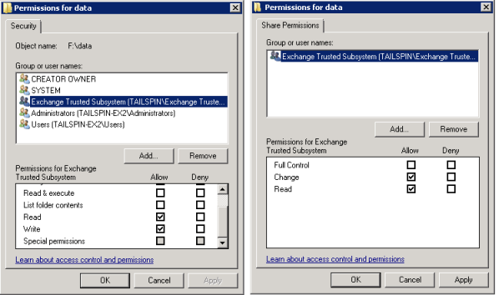
SERVER I

Slide 10
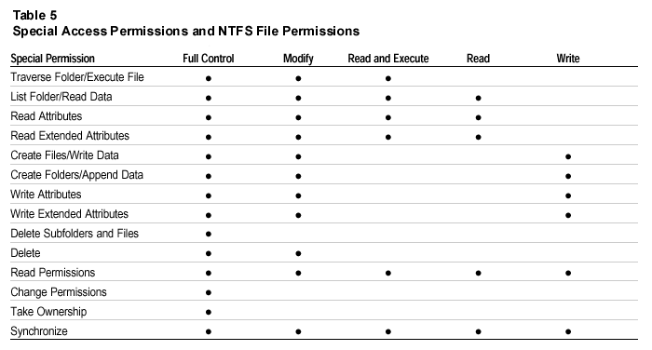
SERVER I

Slide 11
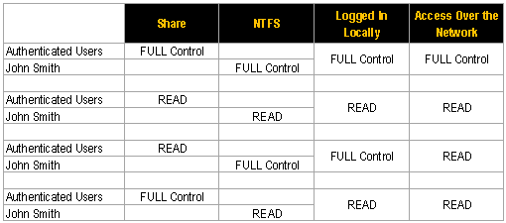
SERVER I

Slide 12
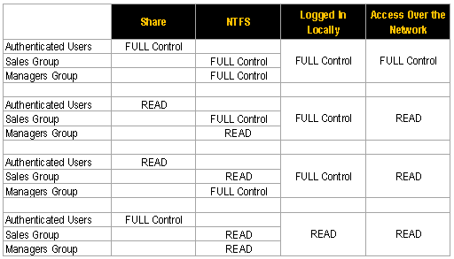
SERVER I

Slide 13
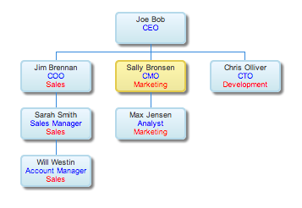
Task 3:
Add 10 GB Volume to your SERVER and Configure File Server
Create shares, groups and users on your WINDOWS SERVER 2012 or WINDOWS SERVER 2012 R2 according to following organization chart. Configure following conditions on network shares.
Provide full access share to relavents users.
Joe Bob has read write permission to all shares.
Joe Bob has NTFS full deny permission on a Deveopment share.
Will Westin has read access to all other shares.
Sara Smith is denied access to Marketing and Development share.
Sales Manager group has full access to CEO and Development share.

