Slide 1
SERVER I
SLIDE: 6

Slide 2
SERVER I
Topics:
Objective 4.3: Deploy and configure the DNS service
Objective 5.1: Install domain controllers

Slide 3
SERVER I
Objective 4.3: Deploy and configure the DNS service

Slide 4
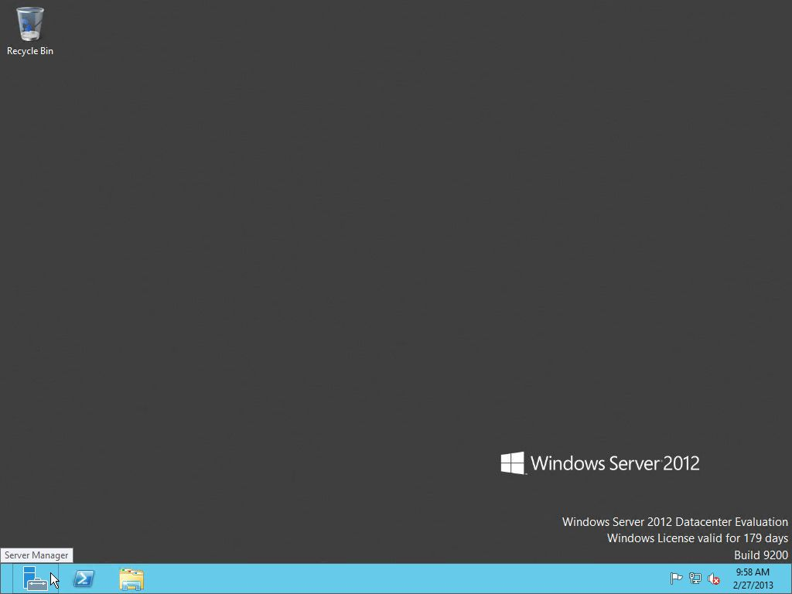
SERVER I

Slide 5
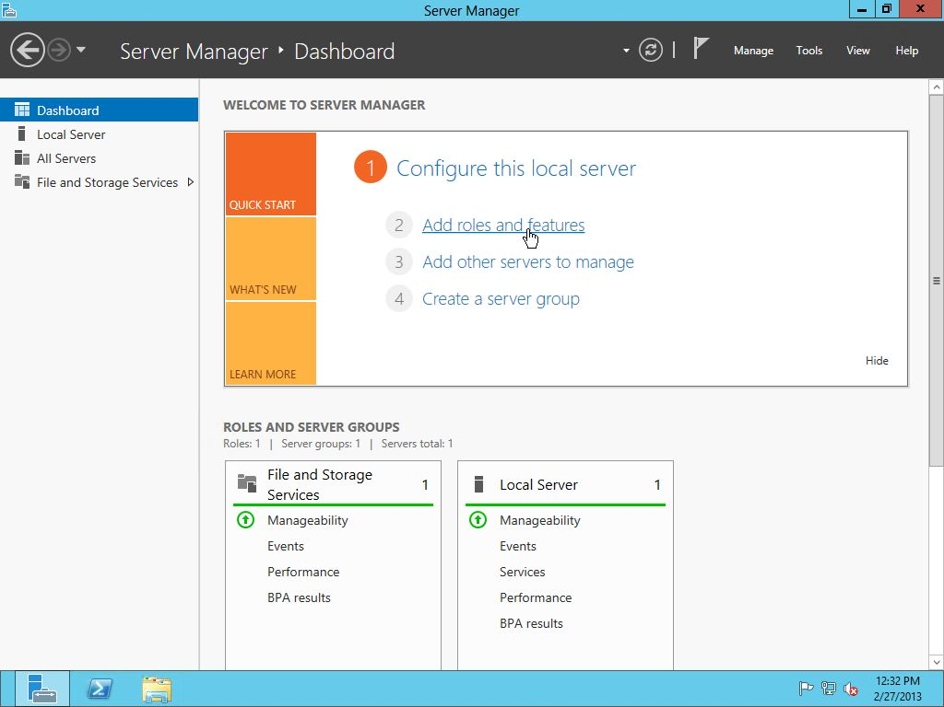
SERVER I

Slide 6
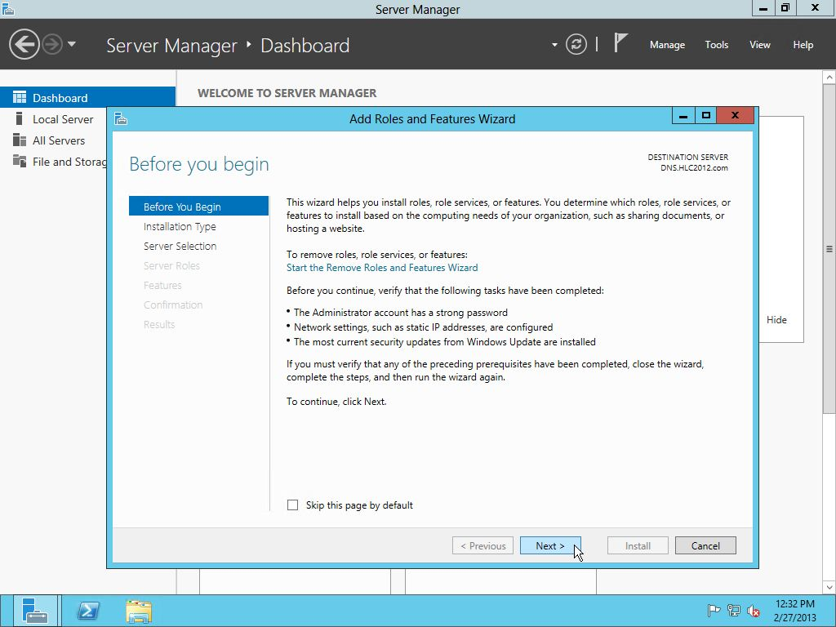
SERVER I

Slide 7
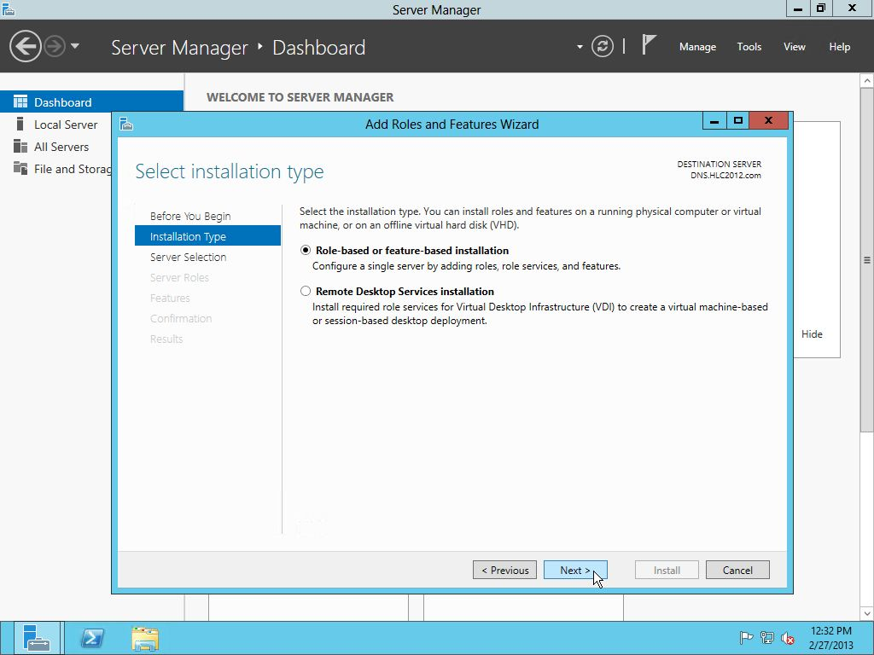
SERVER I

Slide 8
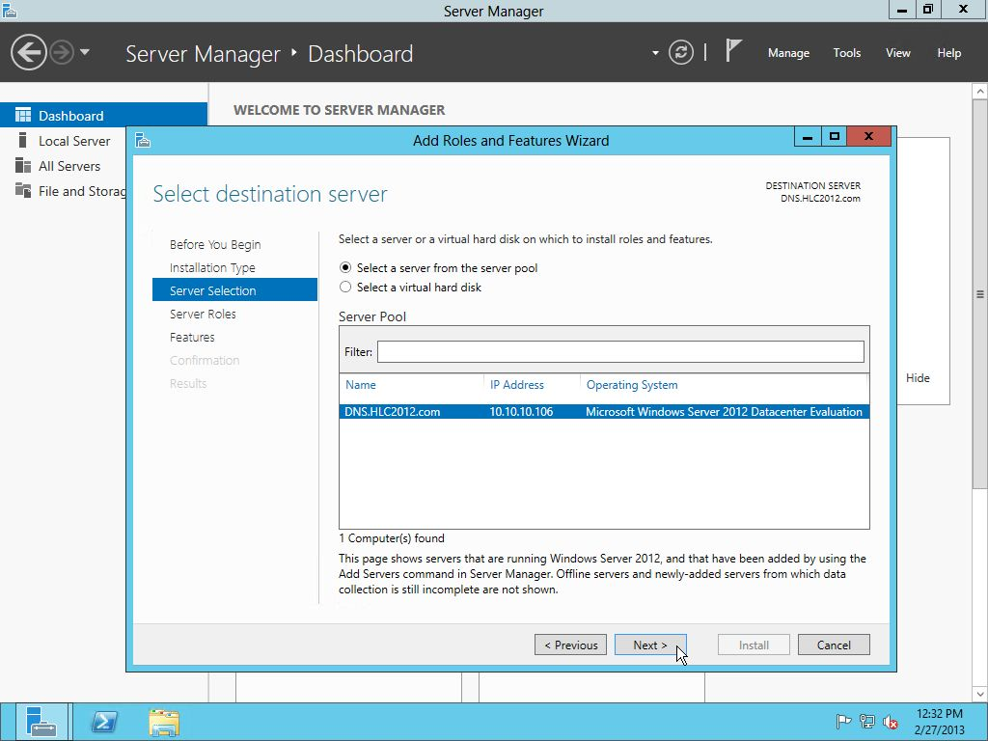
SERVER I

Slide 9
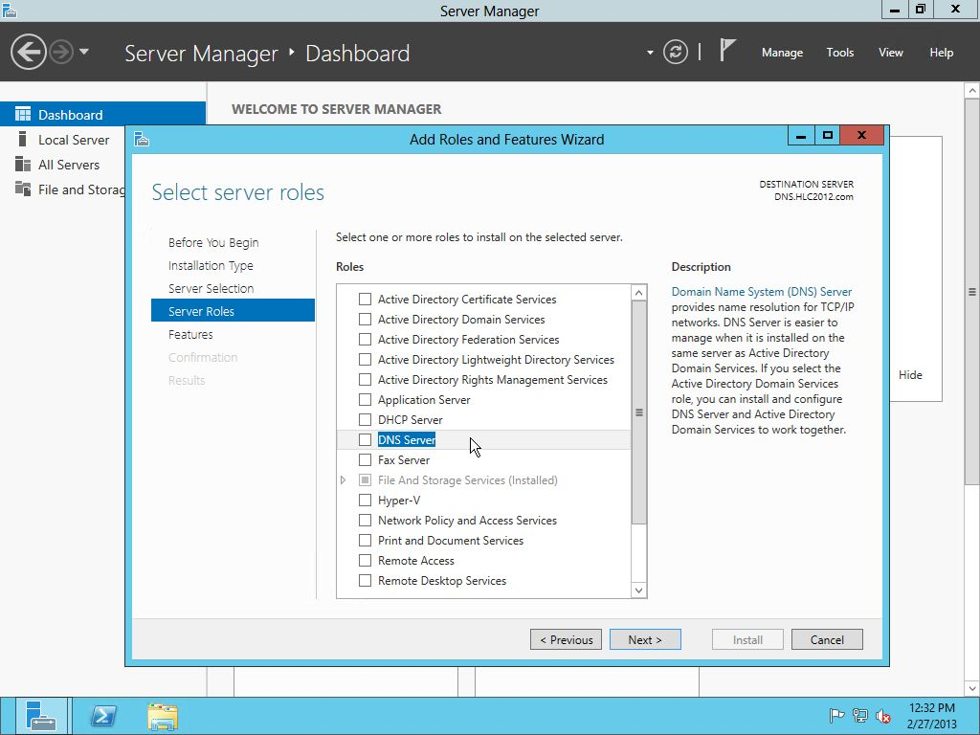

Slide 10
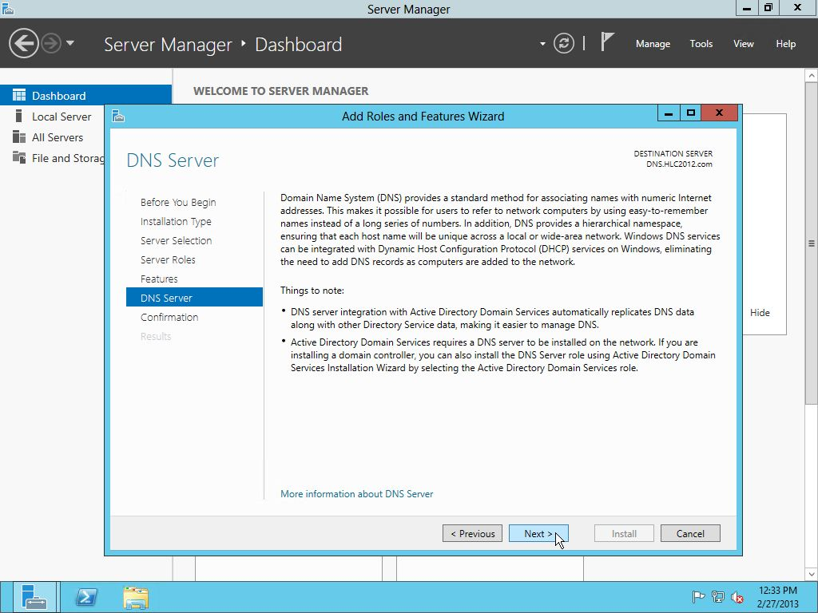

Slide 11
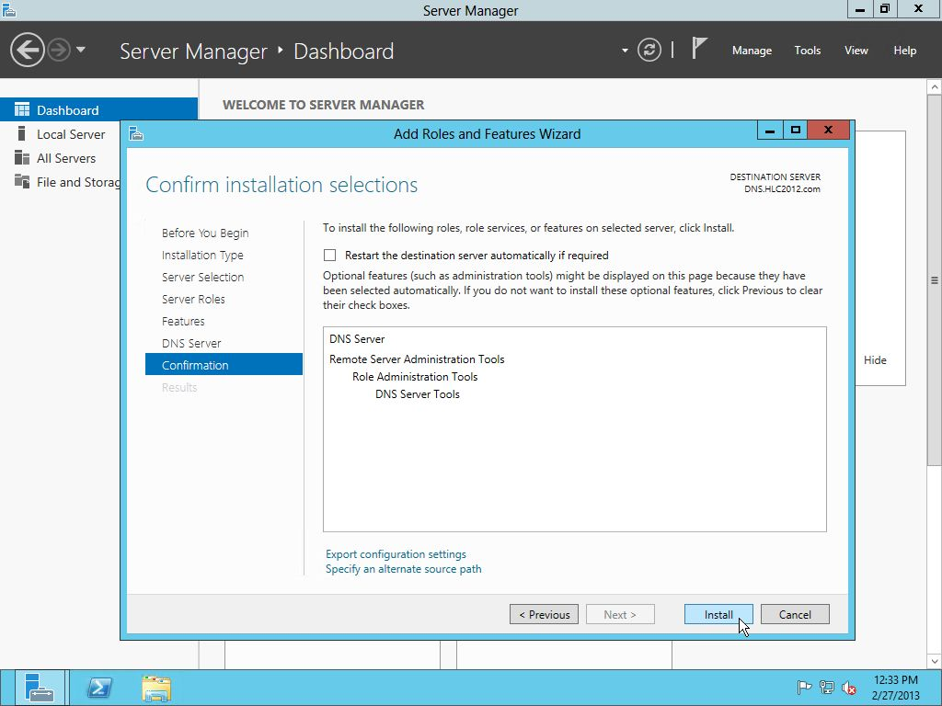

Slide 12
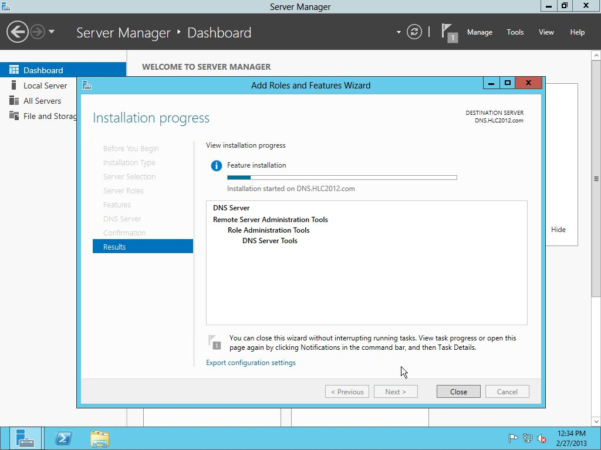

Slide 13
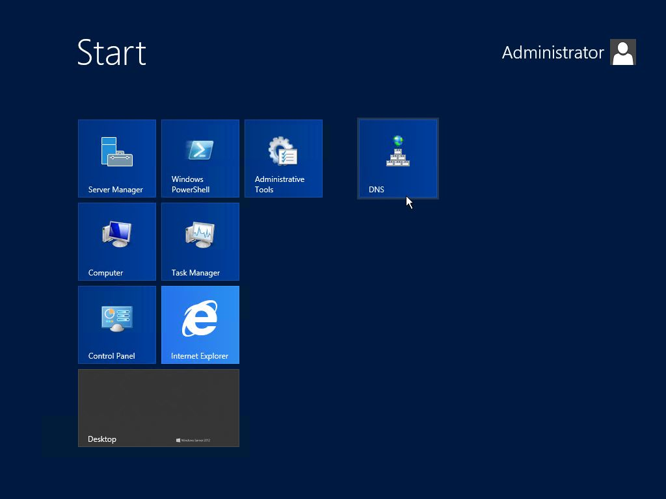

Slide 14
SERVER I

Slide 15
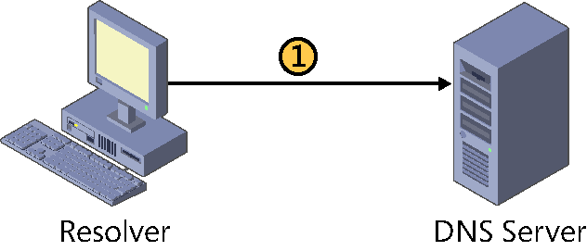
SERVER I

Slide 16
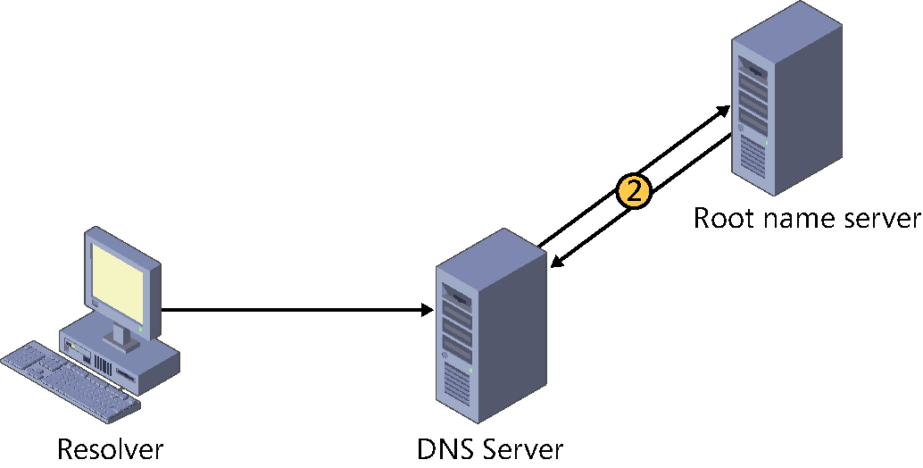
SERVER I

Slide 17
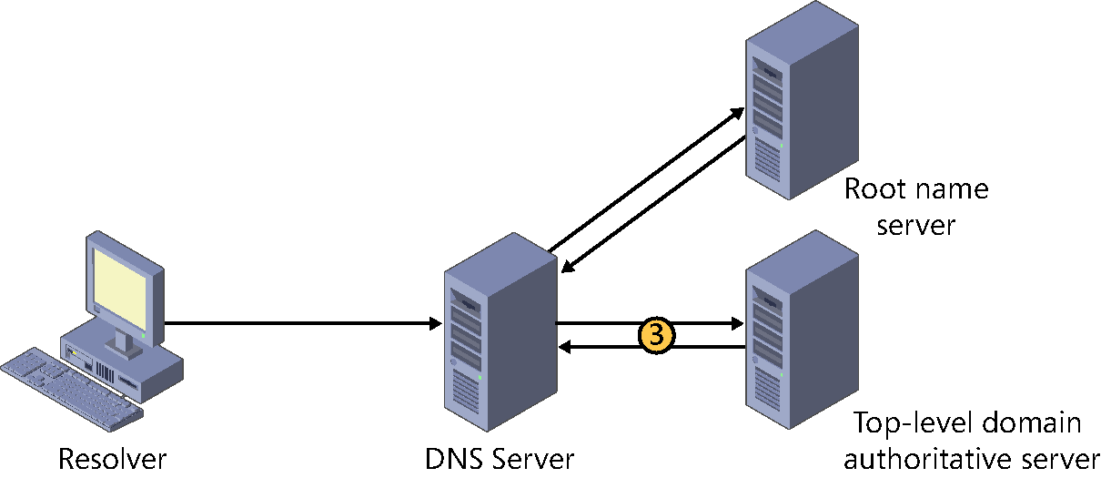
SERVER I

Slide 18
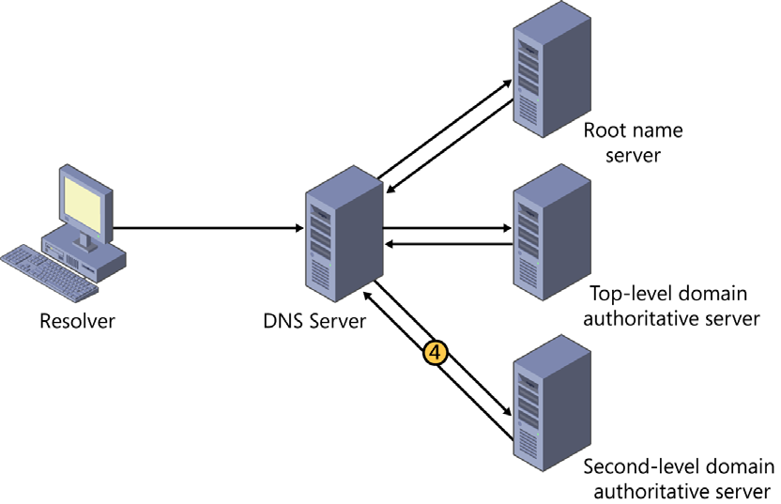
SERVER I

Slide 19
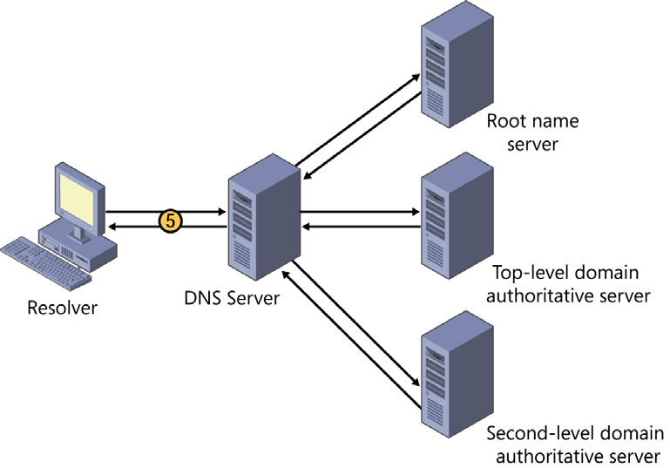
SERVER I

Slide 20
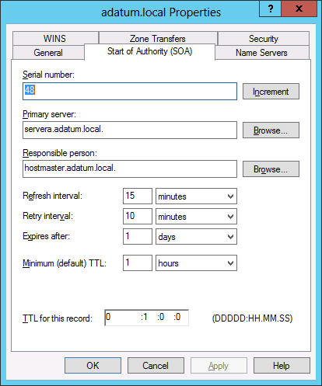
The Start Of Authority (SOA) tab on a DNS server’s Properties sheet

Slide 21
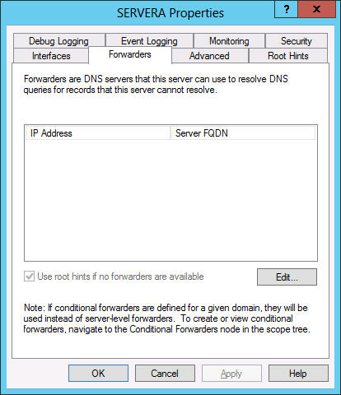
The Forwarders tab on a DNS server’s Properties sheet

Slide 22
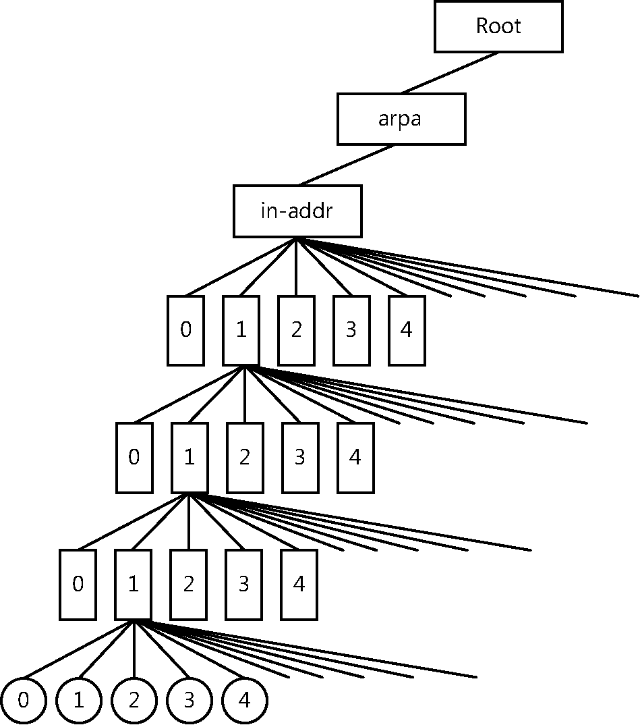
The DNS reverse lookup domain

Slide 23
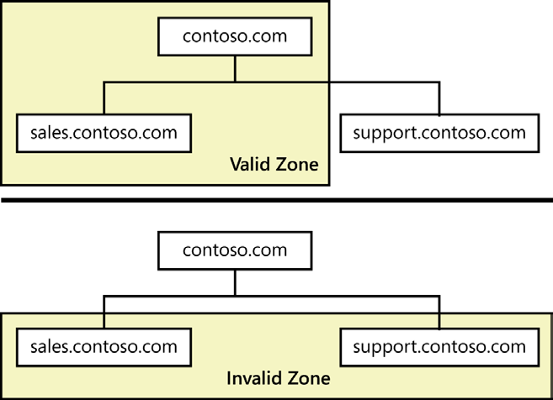
Valid zones must consist of contiguous domains

Slide 24
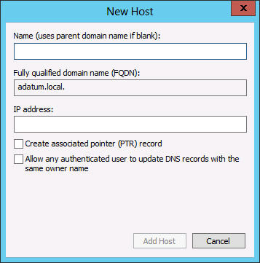
The New Host dialog box

Slide 25
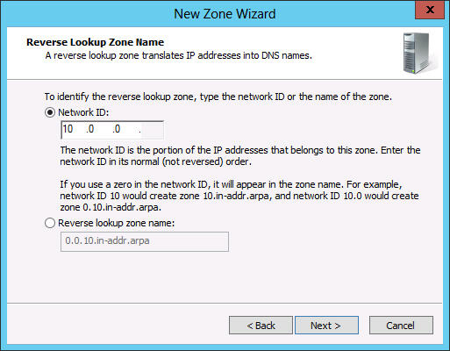
A Reverse Lookup Zone Name page in the New Zone Wizard

Slide 26
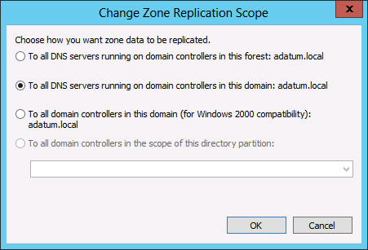
The Change Zone Replication Scope dialog box

Slide 27
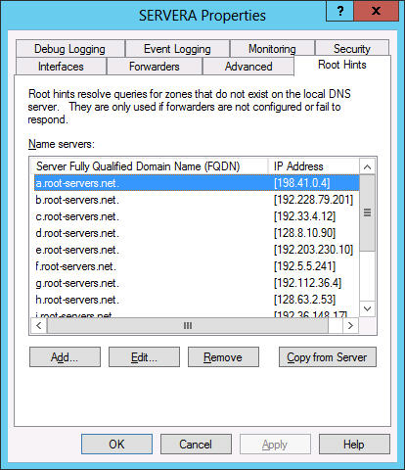
The Root Hints tab on a DNS server’s Properties sheet

Slide 28
The Root Hints tab on a DNS server’s Properties sheet

Slide 29
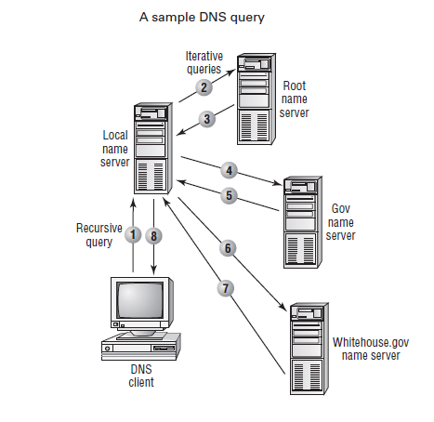
Recursive query vs. Iterative query

Slide 30
SERVER I
Objective 5.1: Install Domain Controllers

Slide 31
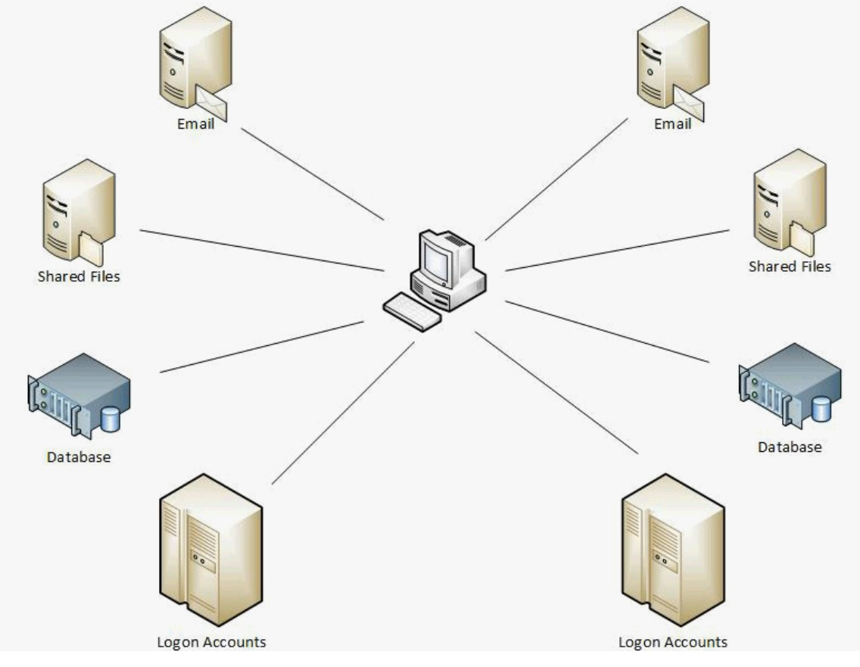
Why AD ?

Slide 32
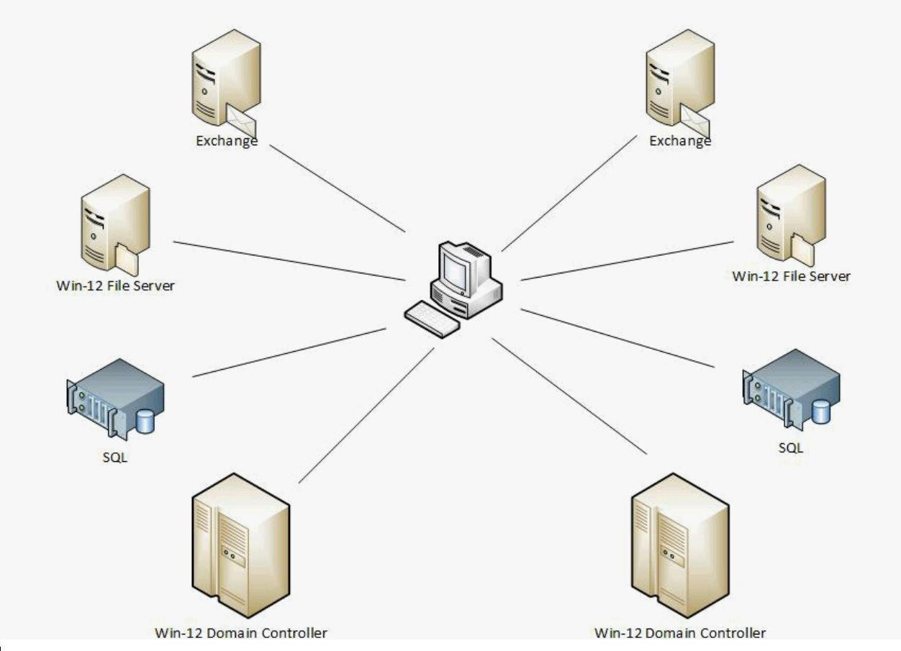
Why AD ?

Slide 33
What AD is ?
A Database (NTDS.DIT) ON A Domain Controller
BASED on X.500 / LDAP
USES KERBEROS
CONSISTENT SYNC ACROSS PEER DC’s
EXTENSIBLE
INTEROPERATES WITH OTHER DOMAINS / FORESTS

Slide 34
AD STRUCTURE
DOMAIN
TREE
FOREST
TRUST
FEDERATION

Slide 35
AD OBJECTS
USERS
GROUP
COMPUTER
OU (ORGANIZATION UNIT)
SITE
SITE LINKS

Slide 36
Open Standards
LDAP
Low-Level API to Active Directory
X.500
Active Directory Structure
Not fully standard-compliant
DNS
Resource Location
Extensions, e. G. „Dynamic DNS“
Kerberos
Authentication

Slide 37
Active Directory Structure
Hierarchical
Base object Domain
Domain
Tree
Forest
OU
Domain
Domain
Domain
OU
OU
Tree
Domain
Domain
Objects

Slide 38
Shortcut-Trusts
Domain A users frequently access Domain B’s Resources
No Change in logical Structure
Domain
Tree
Forest
OU
Domain A
Domain
Domain
OU
OU
Tree
Domain
Domain B
Objects

Slide 39
Which objects does Active Directory contain?
„old Friends “
User
Group
Computer
New Elements
Distribution Lists
System Policies
Application defined custom objects
Described in the Schema

Slide 40
What is the Schema?
Definition of all AD
Object-Types (Classes)
Attributes
Data-Types (Syntaxes)
Can be compared to a Database Schema
ONE consistent Schema inside a single Forest
Extensible

Slide 41
What is a Domain?
AD Base Element (Building Block)
NT 4 Compatible
Physically Implemented on Domain Controllers (DC)
Border for
Replication Traffic
System Policies
Administration
Firma.de

Slide 42
What is an Organizational Unit (OU)?
Implements a Structure inside a Domain
Can be nested as needed
Typically used for Administrative Reasons
e.g. System Policies
LA
New York
Admin
Sales
Admin
Sales

Slide 43
What is a Tree?
Hierarchical Domain Structure inside a single Namespace
adiscon.com
la.adiscon.com
ny.adiscon.com
Transitive Trusts created automatically
Sub-Domain must be added to Root-Domain – otherwise there will be no tree!
adiscon.com
Tree
la.adiscon.com
ny.adiscon.com

Slide 44
What is a Forest?
Combination of Trees
Disjunct Namespaces
adiscon.de
adiscon.com
Transitive Trusts created automatically
There is one single tree-root!
Sub-Tree must be added to Root-Tree, otherwise no Forest will be created

Slide 45
The Tree-Root
First Domain installed
Single Schema
Absolutely vital!
Domain
Tree
Forest
OU
Domain
Domain
Domain
OU
OU
Tree
Domain
Domain
Objects

Slide 46
Modeling the physical Structure
Not related to logical Structure
Modeled via „Sites“
A site is well connected via fast Network Links
One Site can home multiple Domains
One Domain can spread across many Sites
Domain Database is stored on Domain Controllers

Slide 47
Sample Site Structure
Logical and physical Structure are totally independent of each other!
Site LA
Site New York
Adiscon.com
sales.adiscon.com
sales.adiscon.com

Slide 48
Which Role can a Server have?
Member Server
Domain Controller
Global Catalog
FSMO
Special Roles carried out by only a limited set of Servers
e.g. PDC Emulator
e.g. Schema Master

Slide 49
What is a Domain-Controller?
Stores a physical Copy of the Active Directory Database
Currently a single Domain per DC supported!
ESE95 Database (MS Exchange)
Logon Services
Kerberos
LAN Manager Authentication
Recommendation: always have at least 2 Domain Controllers!

Slide 50
What is a Global Catalog Server?
Answers AD Search Queries
Must be present to successfully logon
Holds a copy of all Objects of the whole Forest…
...but holds only a subset of the Attributes
User definable
Recommendation: at least one GC per (larger) Site

Slide 51
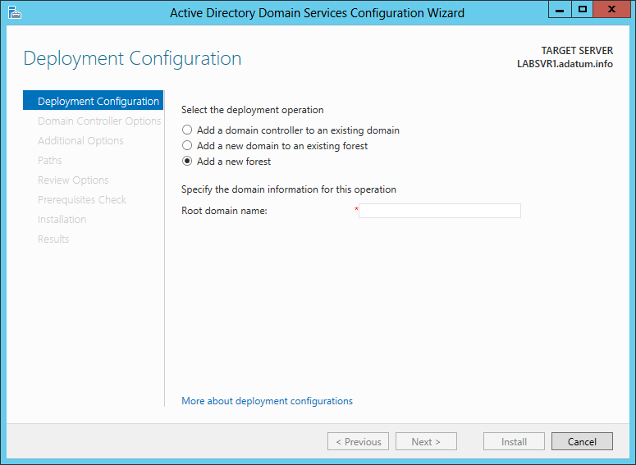
The Deployment Configuration page of the Active Directory Domain Services Configuration Wizard

Slide 52
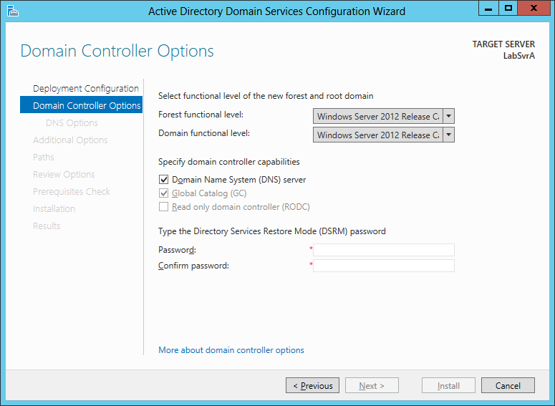
The Domain Controller Options page of the Active Directory Domain Services Configuration Wizard

Slide 53
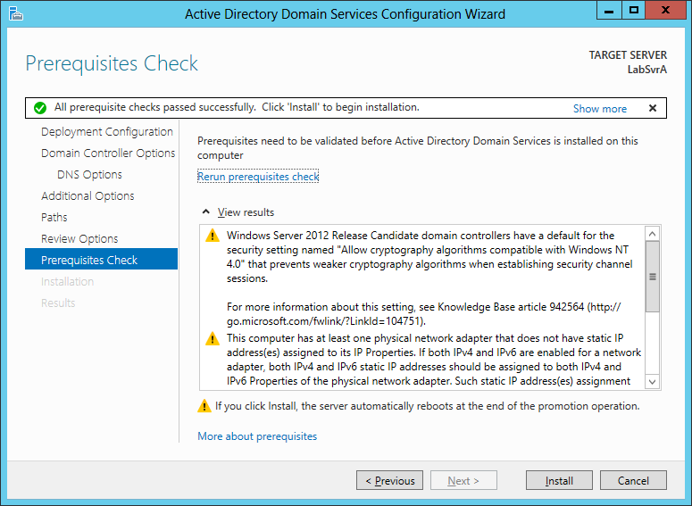
The Prerequisites Check page of the Active Directory Domain Services Configuration Wizard

Slide 54
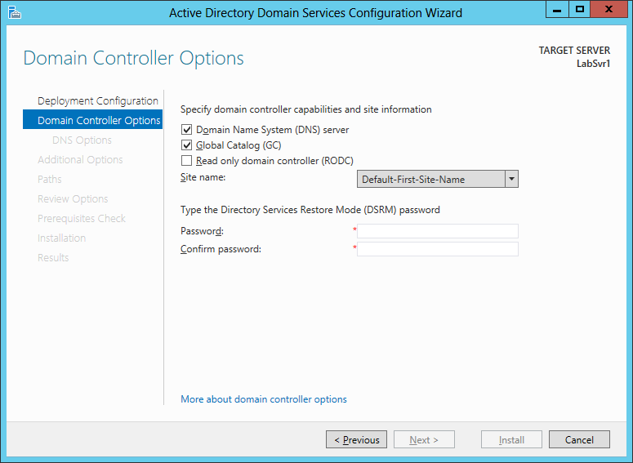
The Domain Controller Options page of the Active Directory Domain Services Configuration Wizard

Slide 55
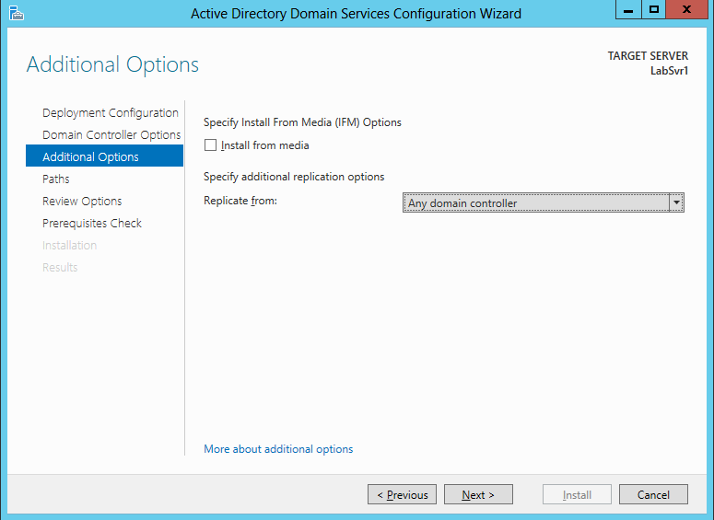
The Additional Options page of the Active Directory Domain Services Configuration Wizard

Slide 56
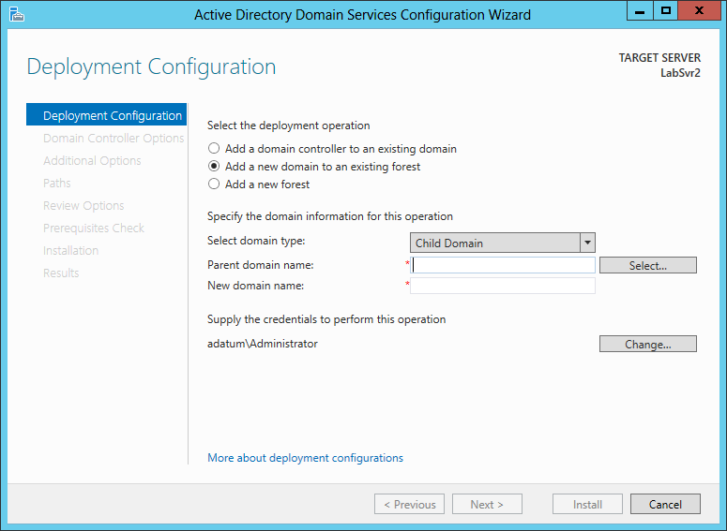
The Deployment Configuration page of the Active Directory Domain Services Configuration Wizard

Slide 57
Syntax for the Install-AddsForest cmdlet in Windows PowerShell

Slide 58
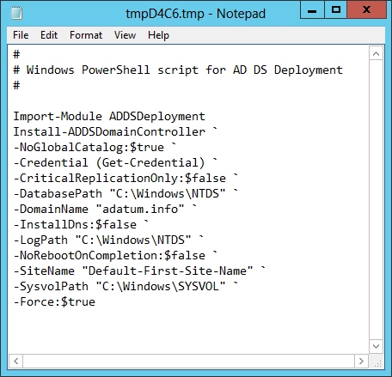
An installation script generated by the Active Directory Domain Services Configuration Wizard

Slide 59
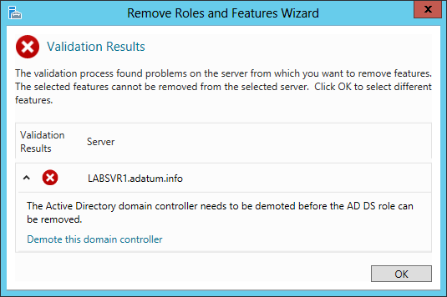
Removing a domain controller

Slide 60
SERVER I
To demote a domain controller by using Windows
PowerShell
Uninstall-ADDSDomainController –ForceRemoval
LocalAdministratorPassword <password> –Force

Slide 61
Task 6:
Install Active Directory Domain Service and DSN on Windows Server 2012.
Test DSN Service.

Slide 62
Task 7:
Join Client PC into domain envirnment.

