Slide 1
SERVER I
SLIDE: 1

Slide 2
Teacher – first part
Anders Dahl Valgreen Data technician in Royal Danish Airforce
IT Teacher at Mercantec
Systems administrator at Technical College, Skjern, Denmark
IT Teacher at Mercantec
Core skills:
Network
Server, Unix and Windows
Faultfinding
Documentation
Project Management

Slide 3
Teacher – second part
AZEEM UMAR BS- Computer Science 2000-2004 - Pakistan
System Engineer 2005-2006 - Pakistan
MS Software Engineering 2006-2008- Sweden
Teaching- Mercantec 2009-
Core skills:
SQL Server
Windows Server
ASP.NET
Powershell
Software Project Management

Slide 4
Course Dates: Sep - Nov 2015
Day | Date
1 | 29th Sep
2 | 30th Sep
3 | 1th Oct
4 | 2nd Oct
5 | 4th Nov
6 | 6th Nov
7 | 9st Nov
8 | 11th Nov
Day | Date
9 | 12th Nov
10 | 17th Nov
11 | 18th Nov

Slide 5
SERVER I
Course Objectives
Installing and Configuring Windows Server 2012 R2
Configuring Server Roles and Features
Configuring Hyper V
Deploying and Configuring Core Networking Services
Installing and Administering Active Directory
Creating and Managing Group Policy

Slide 6
SERVER I
Lesson Plan – part 1, with Anders Dahl Valgreen
Day 1:
■■ Objective 1.1: Install servers
■■ Objective 1.2: Configure servers
■■ Objective 1.3: Configure local storage
Day 2:
■■ Objective 2.1: Configure file and share access
■■ Objective 2.2: Configure print and document services
■■ Objective 2.3: Configure servers for remote management
Day 3:
■■ Objective 3.1: Create and configure virtual machine settings
■■ Objective 3.2: Create and configure virtual machine storage
■■ Objective 3.3: Create and configure virtual networks
Day 4:
■■ Objective 4.1: Configure IPv4 and IPv6 addressing
■■ Objective 4.2: Deploy and configure Dynamic Host Configuration Protocol (DHCP)
■■ Objective 4.3: Deploy and configure DNS service

Slide 7
SERVER I
Lesson Plan – Part 2, with Azeem Umar
Day 5:
■■ Objective 5.1: Install domain controllers
■■ Objective 5.2: Create and manage Active Directory users and computers
■■ Objective 5.3: Create and manage Active Directory groups and organizational units (OUs)
Day 6:
■■ Objective 6.1: Create Group Policy Objects (GPOs)
■■ Objective 6.2: Configure security policies
Day 7:
■■ Objective 6.3: Configure application restriction policies
Day 8:
■■ Objective 6.4: Configure Windows Firewall

Slide 8
SERVER I
What is a SERVER?

Slide 9
SERVER I
Lesson Plan
Day 1:
■■ Objective 1.1: Install servers
■■ Objective 1.2: Configure servers
■■ Objective 1.3: Configure local storage

Slide 10
SERVER I
Objective 1.1: Install servers
■■ Plan for a server installation
■■ Plan for server roles
■■ Plan for a server upgrade
■■ Install a server using Server Core
■■ Optimize resource utilization using Features on Demand
■■ Migrate roles from previous versions of Windows Server

Slide 11
SERVER I
Objective 1.1: Install servers
■■ Plan for a server installation
Selecting a Windows Server 2012 R2 edition
Windows Server 2012 R2 Datacenter
Windows Server 2012 R2 Standard
Windows Server 2012 R2 Essentials
Windows Server 2012 R2 Foundation
Supporting server roles

Slide 12
SERVER I
Objective 1.1: Install servers
■■ Supporting server virtualization

Slide 13
SERVER I
Objective 1.1: Install servers
■■ Server licensing

Slide 14
SERVER I
Objective 1.1: Install servers
Installation requirements
■■ 1.4-GHz 64-bit processor
■■ 512 MB RAM
■■ 32 GB available disk space
■■ Super VGA (1024 x 768) or higher resolution monitor
■■ Keyboard and mouse (or other compatible pointing device)
■■ Internet access

Slide 15
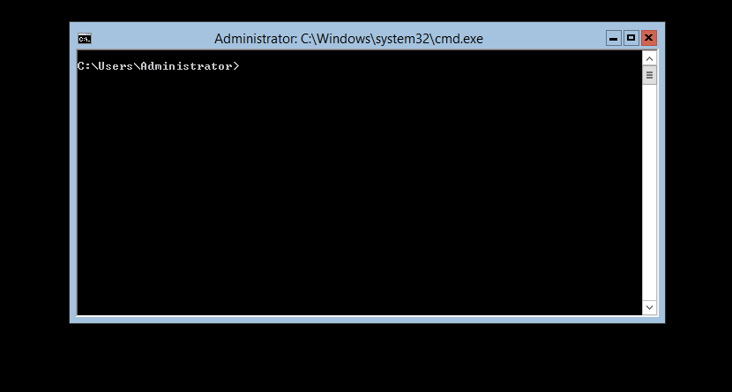
SERVER I
Objective 1.1: Install servers
Choosing installation options
Using Server Core

Slide 16
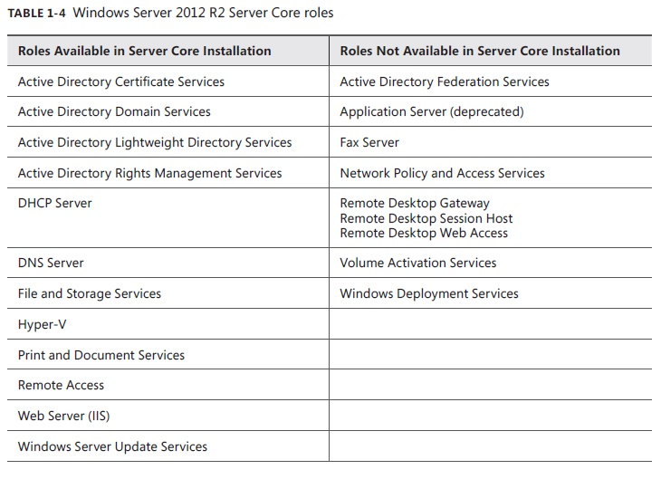
SERVER I
Objective 1.1: Install servers
Choosing installation options
SERVER CORE CAPABILITIES

Slide 17
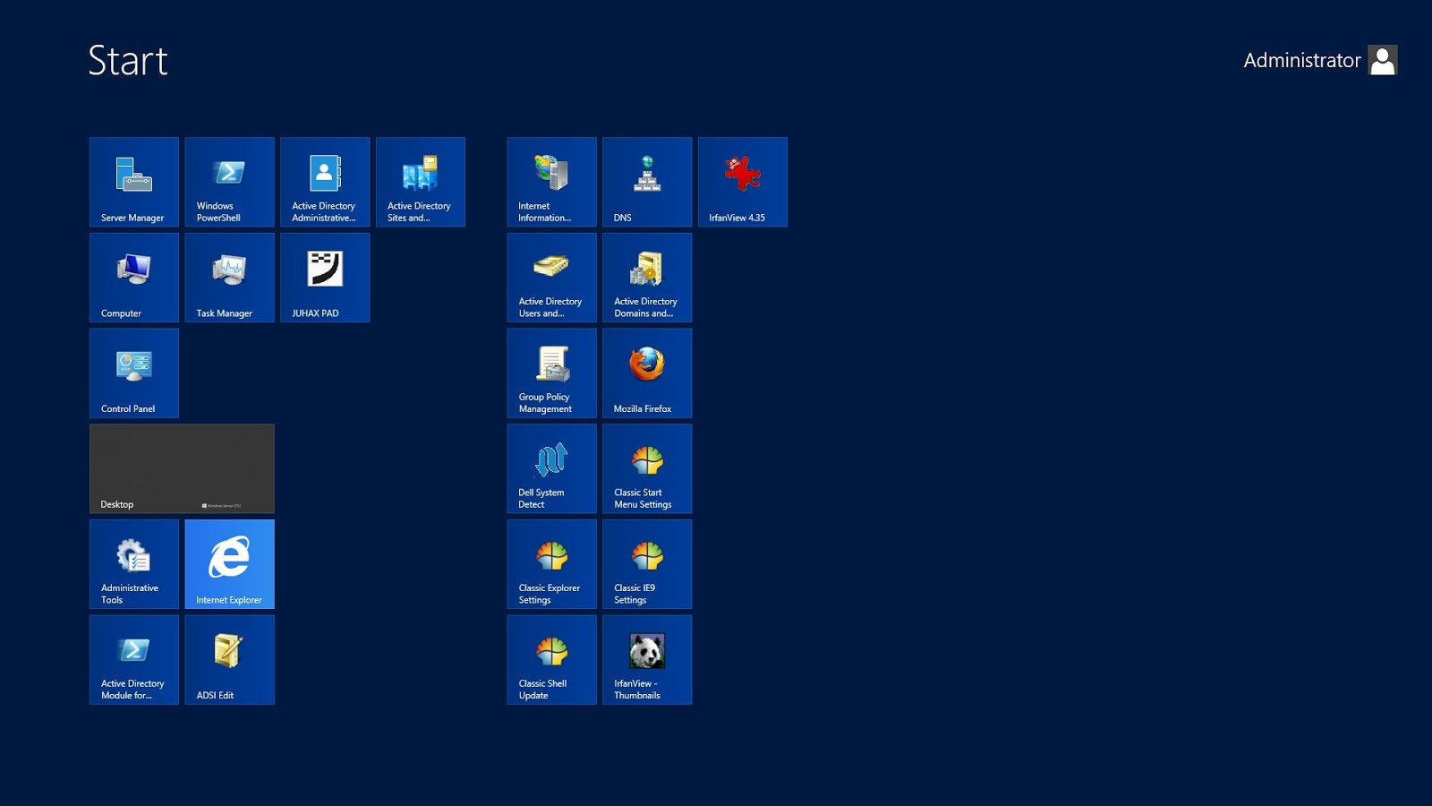
SERVER I
Objective 1.1: Install servers
Choosing installation options
Using Full GUI

Slide 18
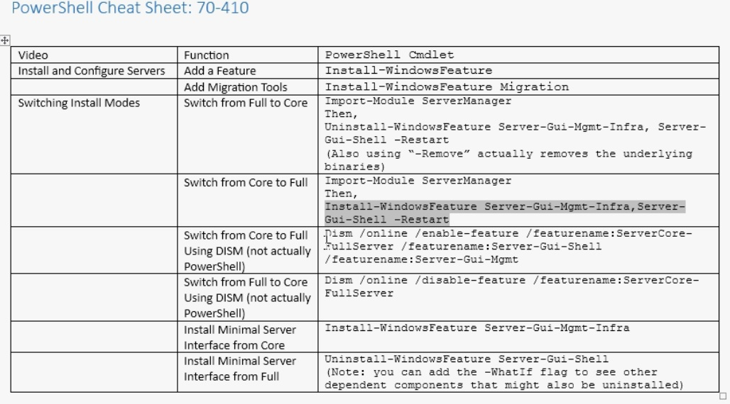
SERVER I

Slide 19
SERVER I
Objective 1.1: Install servers
Upgrading server
Upgrade paths
If you have a 64-bit computer running Windows Server 2008 or Windows Server 2008 R2, you can upgrade it to Windows Server 2012 R2 as long as you use an appropriate operating system edition.
Windows Server 2012 R2 does not support the following:
■■ Upgrades from Windows Server versions prior to Windows Server 2008
■■ Upgrades from pre-RTM editions of Windows Server 2012 R2
■■ Upgrades from Windows workstation operating systems
■■ Cross-platform upgrades, such as 32-bit Windows Server 2008 to 64-bit Windows Server 2012 R2
■■ Upgrades from any Itanium edition
■■ Cross-language upgrades, such as from Windows Server 2008, U.S. English to Windows
Server 2012 R2, French

Slide 20
SERVER I
Objective 1.1: Install servers
Upgrading server
Check hardware compatibility
Check disk space
Confirm that software is signed
Save mass storage drivers on removable media
Check application compatibility
Ensure computer functionality
Perform a full backup
Disable virus protection software
Disconnect the UPS device
Purchase the correct Windows Server 2012 R2 edition

Slide 21
SERVER I
Objective 1.1: Install servers
Migrating roles
Unlike an in-place upgrade, a migration copies vital information from an existing server to a clean Windows Server 2012 R2 installation.
By using the Windows Server Migration Tools and migration guides supplied with Windows
Server 2012 R2, you can migrate data between servers under any of the following conditions:
■■ Between versions
You can migrate data from any Windows Server version from Windows Server 2003 SP2 to Windows Server 2012 R2. This includes migrations from one server running Windows Server 2012 R2 to another.
■■ Between platforms
You can migrate data from a 32-bit or 64-bit server to a 64-bit server running Windows Server 2012 R2.
■■ Between editions
You can migrate data between servers running different WindowsServer editions.
■■ Between physical and virtual instances You can migrate data from a physical
server to a virtual one, or the reverse.
■■ Between installation options
You can migrate data from one server to another, even when one server is using the Server Core installation option and the other is using the Server with a GUI option.

Slide 22
SERVER I
Break

Slide 23
SERVER I
Objective 1.2: Configure servers
■■ Configure Server Core
■■ Delegate administration
■■ Add and remove features in offline images
■■ Deploy roles on remote servers
■■ Convert Server Core to and from full GUI
■■ Configure services
■■ Configure NIC teaming
■■ Install and configure Windows PowerShell Desired State Configuration (DSC)

Slide 24
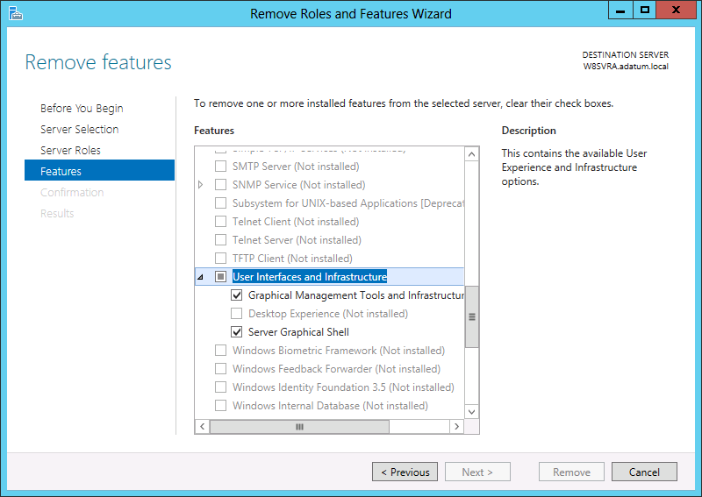
SERVER I
Objective 1.2: Configure servers
■■ Converting between GUI and Server Core
Install-WindowsFeature Server-Gui-Mgmt-Infra,Server-Gui-Shell –Restart

Slide 25
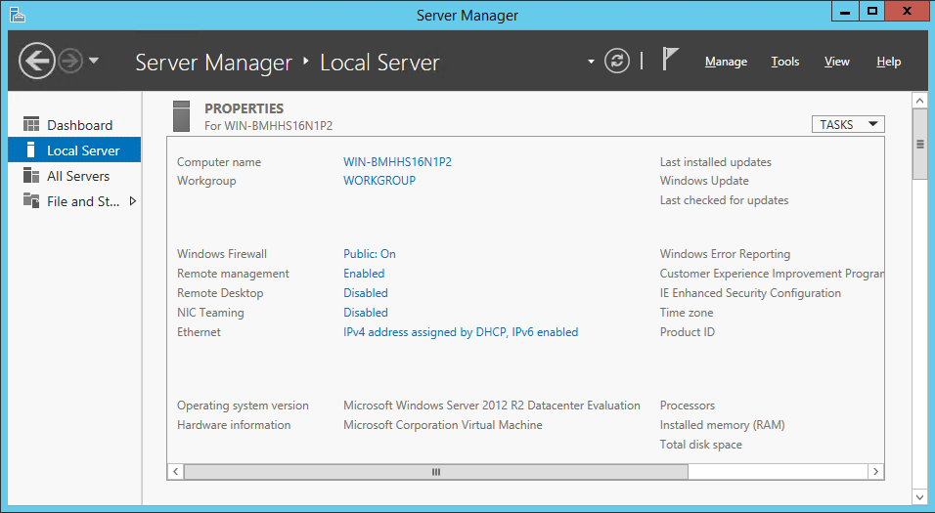
SERVER I
Objective 1.2: Configure servers
Using GUI tools

Slide 26
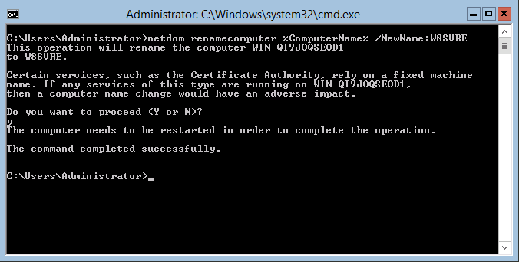
SERVER I
Objective 1.2: Configure servers
Using command-line tools
netdom renamecomputer %ComputerName% /NewName: <NewComputerName>

Slide 27
SERVER I
Objective 1.2: Configure servers
Configuring NIC teaming
NIC teaming in Windows Server 2012 R2 supports two modes:
■■ Switch Independent Mode All the network adapters are connected to different
switches, providing alternative routes through the network.
■■ Switch Dependent Mode All the network adapters are connected to the same
switch, providing a single interface with their combined bandwidth.

Slide 28
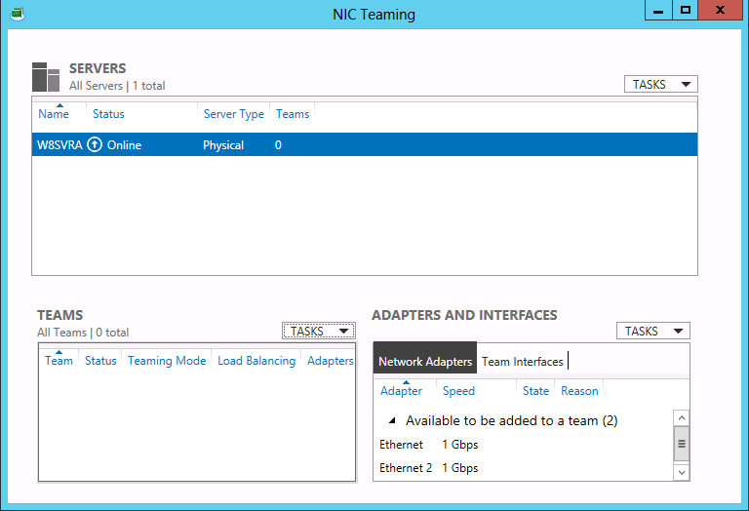
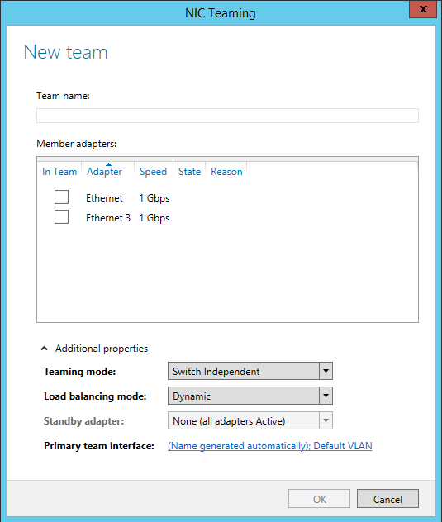
SERVER I
Objective 1.2: Configure servers
Configuring NIC teaming

Slide 29
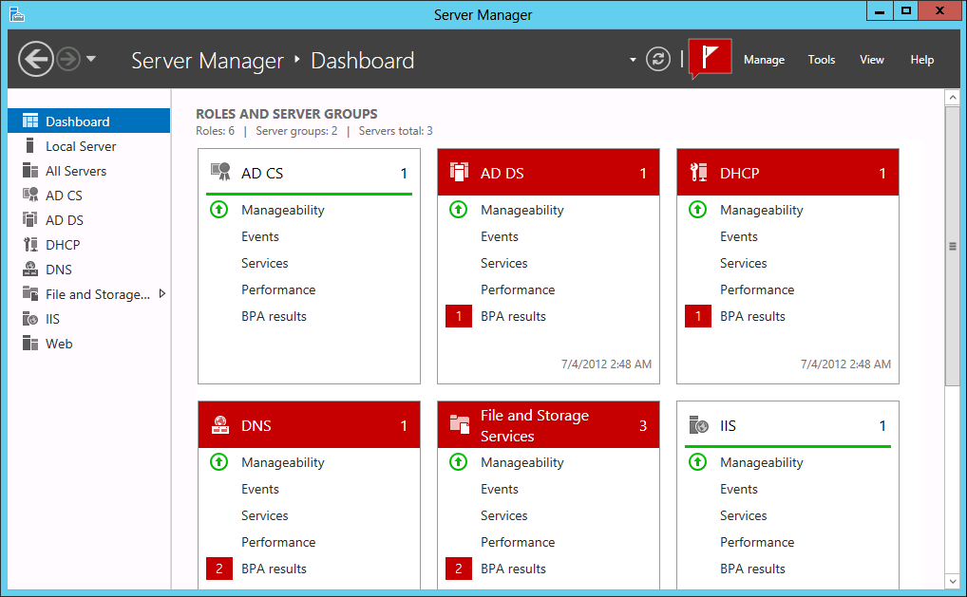
SERVER I
Objective 1.2: Configure servers
Using Server Manager
Adding servers

Slide 30
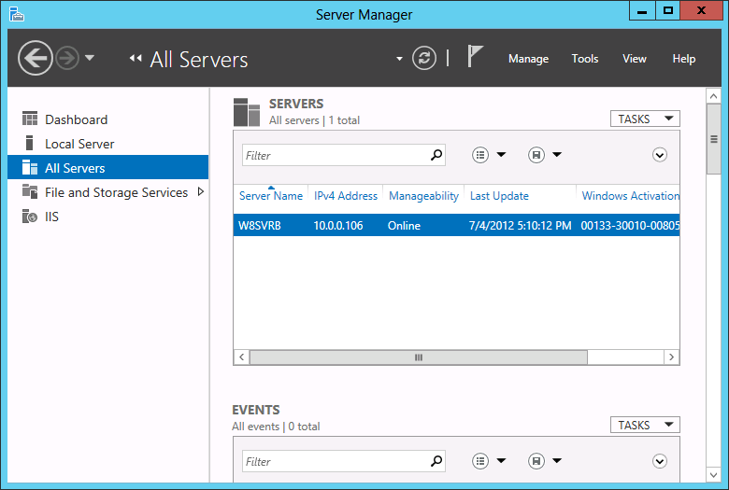
SERVER I
Objective 1.2: Configure servers
Using Server Manager
Adding servers

Slide 31
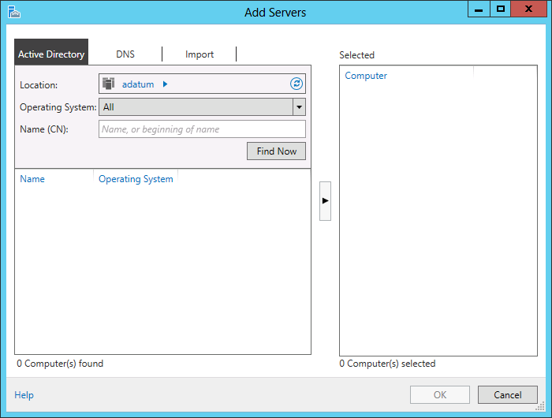
SERVER I
Objective 1.2: Configure servers
Using Server Manager
Adding servers

Slide 32
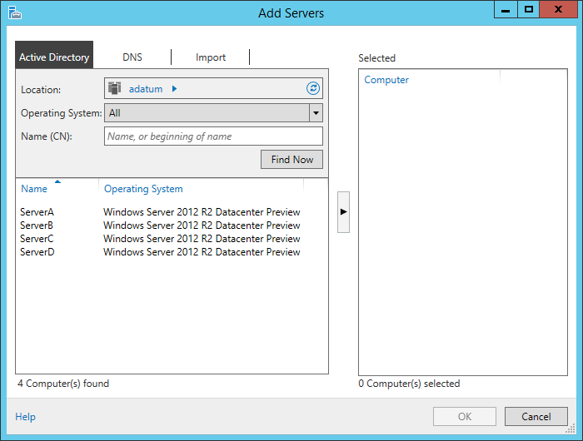
SERVER I
Objective 1.2: Configure servers
Using Server Manager
Adding servers

Slide 33
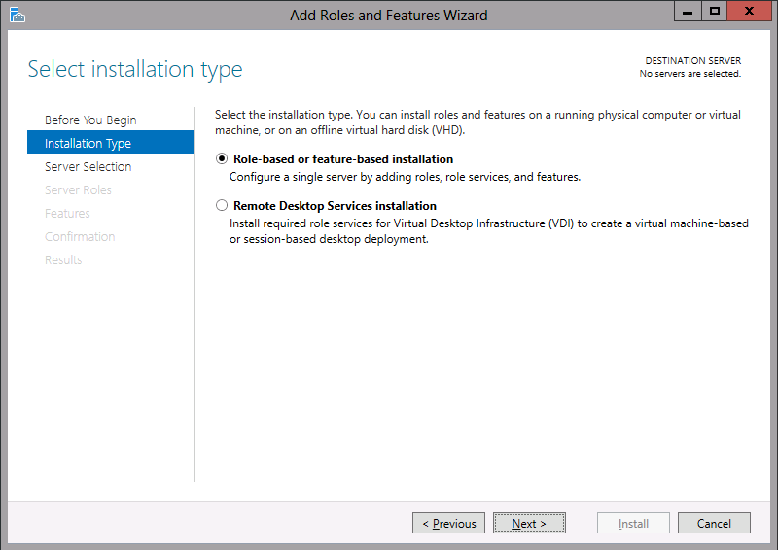
SERVER I
Objective 1.2: Configure servers
Using Server Manager
Adding roles and features

Slide 34
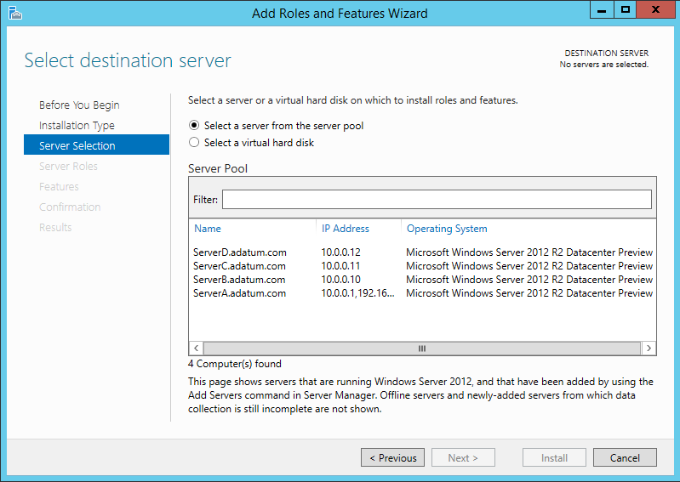
SERVER I
Objective 1.2: Configure servers
Using Server Manager
Adding roles and features

Slide 35
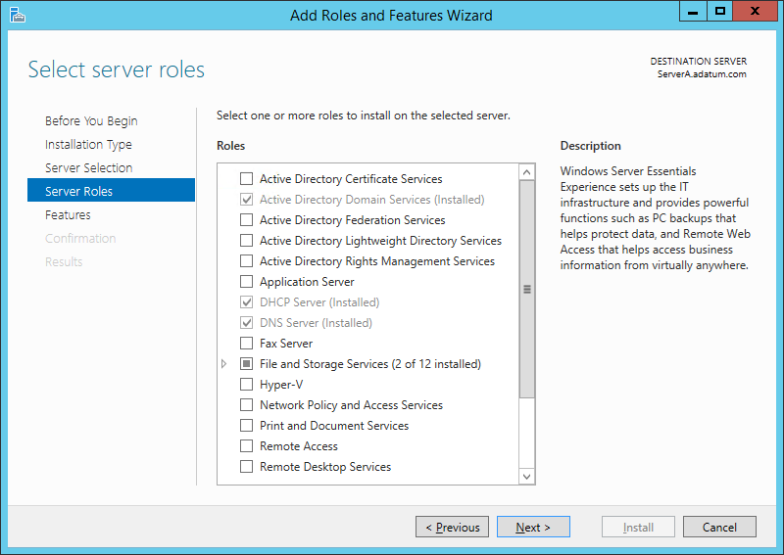
SERVER I
Objective 1.2: Configure servers
Using Server Manager
Adding roles and features

Slide 36
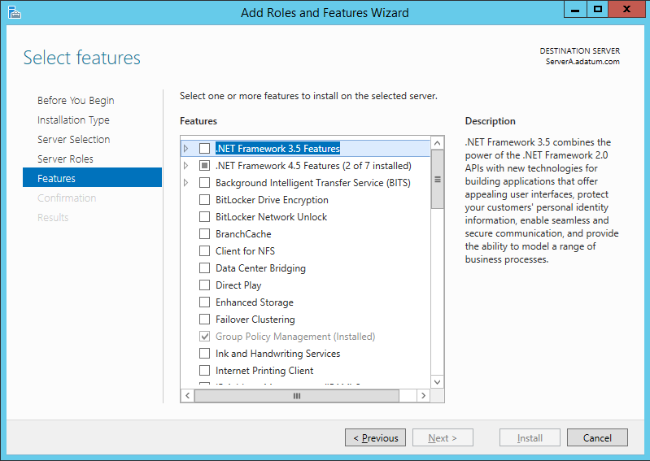
SERVER I
Objective 1.2: Configure servers
Using Server Manager
Adding roles and features

Slide 37
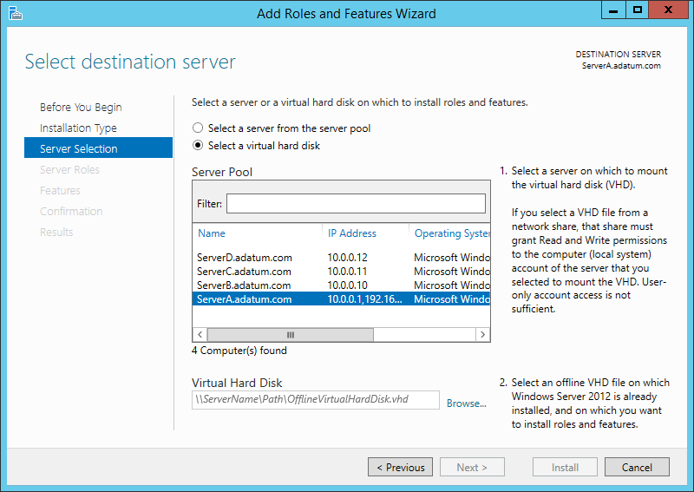
SERVER I
Objective 1.2: Configure servers
Using Server Manager
Deploying roles to VHDs

Slide 38
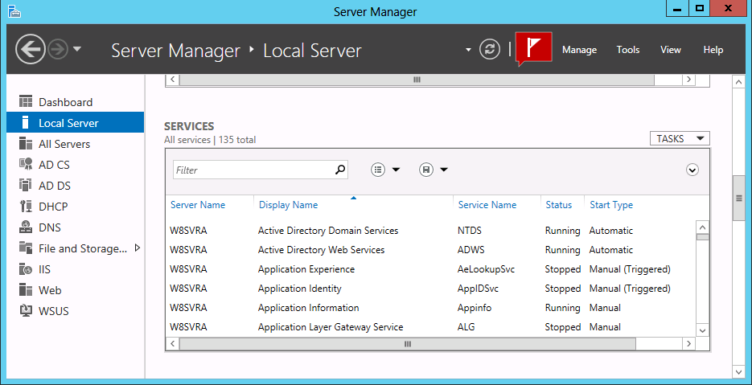
SERVER I
Objective 1.2: Configure servers
Configuring services

Slide 39
SERVER I
Objective 1.2: Configure servers
Delegating server administration
Learn in detail
Objective 2.2
Configure print and document services
Objective 5.3
Create and manage Active Directory groups and organizational

Slide 40
SERVER I
Break

Slide 41
SERVER I
Objective 1.3: Configure local storage
■■ Design storage spaces
■■ Configure basic and dynamic disks
■■ Configure MBR and GPT disks
■■ Manage volumes
■■ Create and mount virtual hard disks (VHDs)
■■ Configure storage pools and disk pools
■■ Create storage pools by using disk enclosures

Slide 42
SERVER I
Objective 1.3: Configure local storage
■■ Design storage spaces
Planning server storage
How many servers do I need?
Estimating storage requirements
Using Storage Spaces

Slide 43
SERVER I
Understanding Windows disk settings
■■ Select a partitioning style Windows Server 2012 R2 supports two hard disk partition
styles: the master boot record (MBR) partition style and the GUID (globally unique
identifier) partition table (GPT) partition style. You must choose one of these partition
styles for a drive; you cannot use both.
■■ Select a disk type Windows Server 2012 R2 supports two disk types: the basic disk
type and the dynamic disk type. You cannot use both types on the same disk drive, but
you can mix disk types in the same computer.
■■ Divide the disk into partitions or volumes Although many professionals use the
terms partition and volume interchangeably, it is correct to refer to partitions on basic
disks and volumes on dynamic disks.
■■ Format the partitions or volumes with a file system Windows Server 2012 R2
supports the NTFS file system, the FAT file system (including the FAT16, FAT32, and
exFAT variants), and the new ReFS file system.

Slide 44
SERVER I
Understanding disk types

Slide 45
SERVER I
Understanding volume types
When you create a volume on a dynamic disk by using the Disk Management snap-in in Windows Server 2012 R2, you choose from the following five volume types:
■■ Simple volume Consists of space from a single disk.
■■ Spanned volume Consists of space from 2 to 32 physical disks
■■ Striped volume Consists of space from 2 to 32 physical disks
■■ Mirrored volume Consists of an identical amount of space on two physical disks
■■ RAID-5 volume Consists of space on three or more physical disks

Slide 46
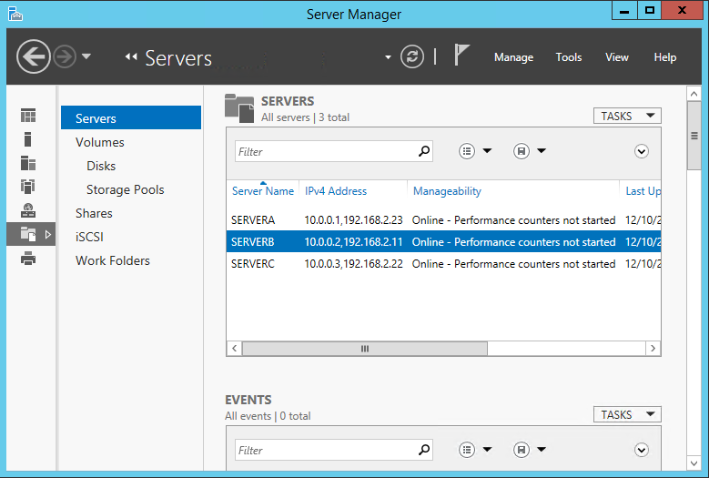
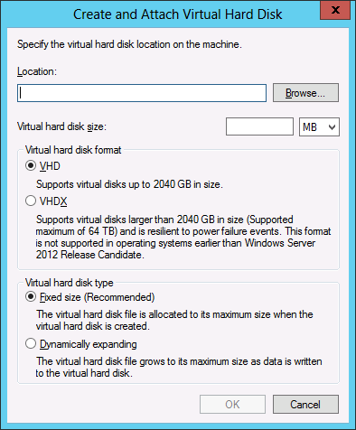
SERVER I
Understanding volume types
Working with disks

Slide 47
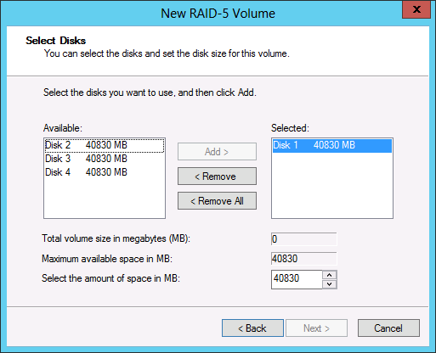
SERVER I
Understanding volume types
Creating a RAID-5 volume

Slide 48
Task 1:
Download and Install VirtualBox
https://www.virtualbox.org/wiki/Downloads
Download and Install Windows Server 2012 R2
Standard (Full GUI)
http://www.microsoft.com/en-us/evalcenter/evaluate-windows-server-2012-r2

Slide 49
Task 2:
Configure Server:
Name the Server
Converting between GUI and Server Core
Configure local storage (1 GB three volumes)
Creating a RAID-5 volume (pg. 61-62)

