Slide 1
SERVER I
SLIDE: 3

Slide 2
SERVER I
Topic for tomorrow:
Chapter 3: Configuring Hyper-V
■■ Objective 3.1: Create and configure virtual machine settings (Group D)
■■ Objective 3.2: Create and configure virtual machine storage (Group E)
■■ Objective 3.3: Create and configure virtual networks (Group F)

Slide 3
SERVER I
Hyper-V Networking and
Virtual Switches Overview
Microsoft Hyper-V, which is a very common
virtualization platform for Windows based servers

Slide 4
SERVER I

Slide 5
SERVER I

Slide 6
SERVER I

Slide 7
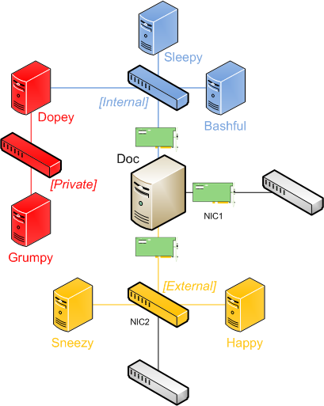
Task 4:
Create following Network infrastructure (Generic)
Hyper-V (Only if Hyper V is available) or on Virtual Box

