Slide 1
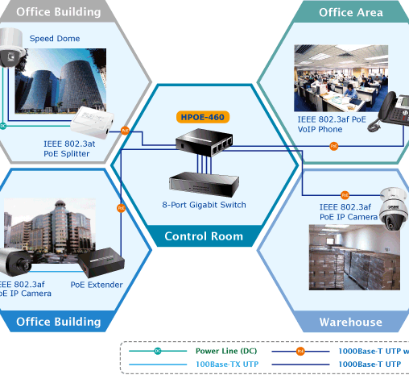
Power over Ethernet
PoE

Slide 2
What is PoE?
Is innovative technology that provides a new, more cost-effective method for powering network devices. As described in the IEEE 802.3af standard, PoE enables delivery of power over existing CAT-5 LAN cabling, eliminating the need for running separate – and expensive power cables.

Slide 3
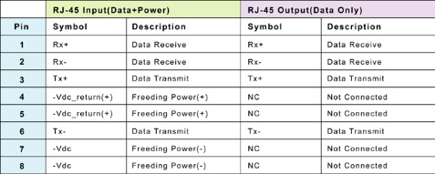
How does PoE work?
PoE provides both data and power connections in one cable, so equipment doesn't require a separate cable for each need. For equipment that does not already have a power or data connection, PoE can be attractive when the power demand is modest. For example, PoE is useful for IP telephones , wireless access points, cameras with pan tilt and zoom (PTZ), and remote Ethernet switches. PoE can provide long cable runs e.g. 100 m and deliver 12 W of galvanically isolated power.

Slide 4
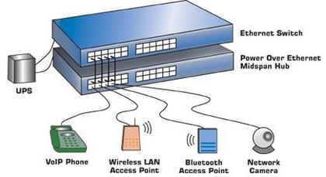
Classification
PD – Powered Devices: PDs are end devices that can accept the power transmitted over Ethernet Cat-5 cable.
PSE – Power Source Equipment: PSEs add power to the ethernet cable.
Midspan device: These are power injectors that stands between the standard ethernet switch and the end device.
Endspan devices (PoE Switches): These are Ethernet Switches that includes the circuit to inject power to the ethernet cable

Slide 5
What are the benefits of PoE?
Saving costs
Safety
Portability
Easy maintenance
Simplicity

Slide 6
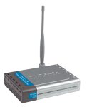
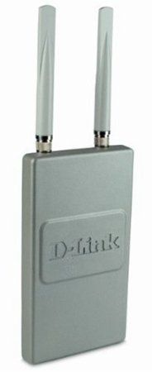
Couple examples

Slide 7
Want more?

