Slide 1
SERVER I
SLIDE: 5

Slide 2
Objectie 4.2

Slide 3
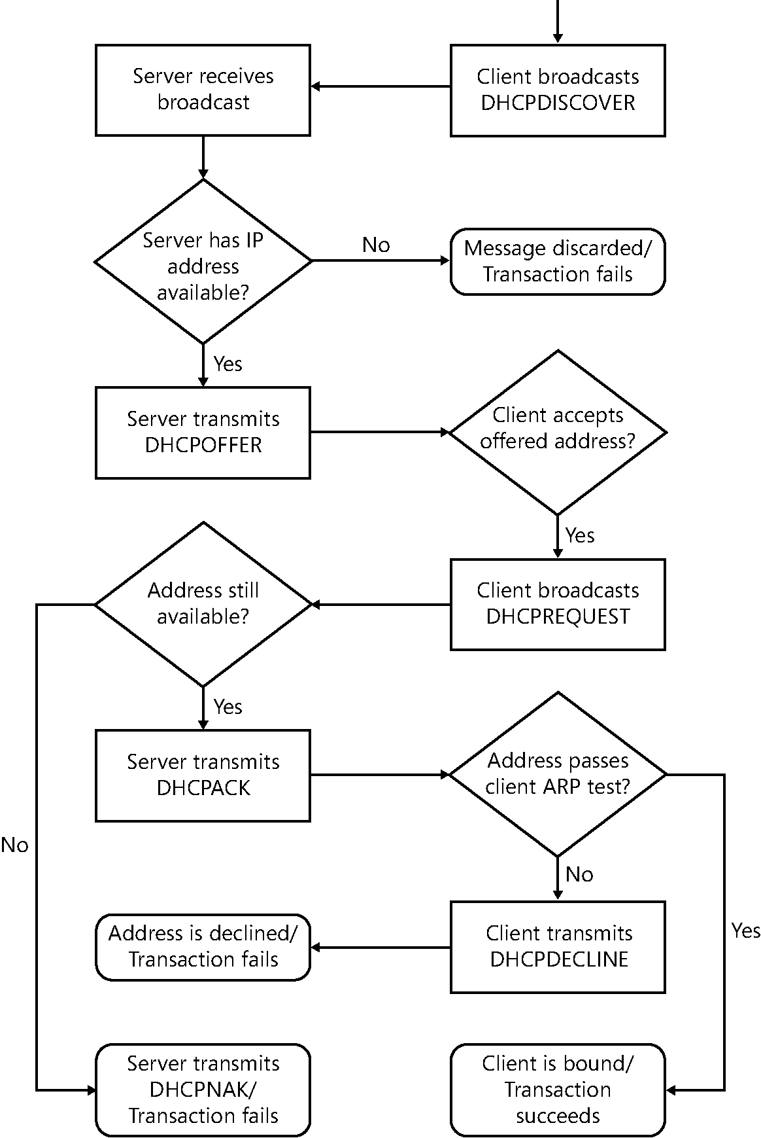
The DHCP IP address assignment process

Slide 4
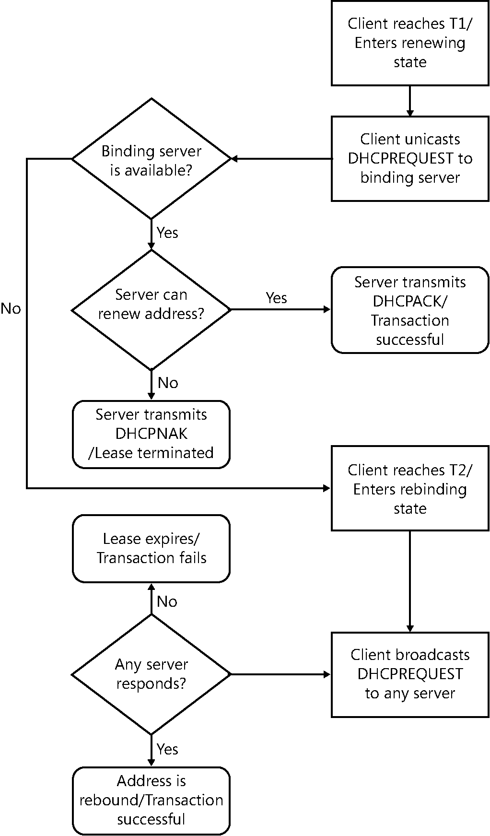
The DHCP IP address renewal process.

Slide 5
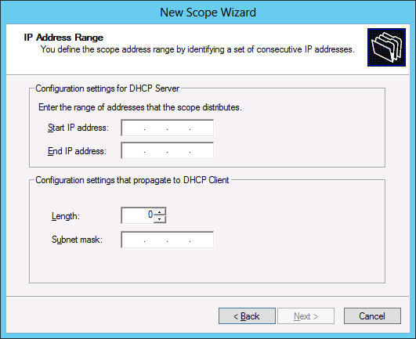
The IP Address Range page in the DHCP console

Slide 6
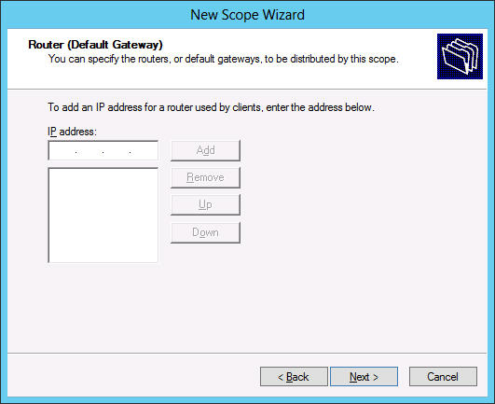
The Router (Default Gateway) page in the DHCP console

Slide 7
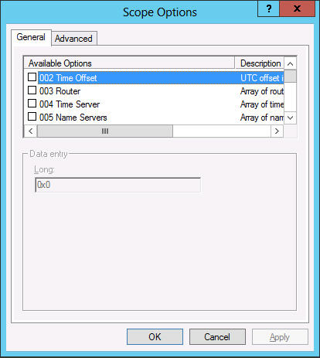
The Scope Options dialog box

Slide 8
???Using PXE ???

Slide 9
??? Deploying a DHCP relay agent???

Slide 10
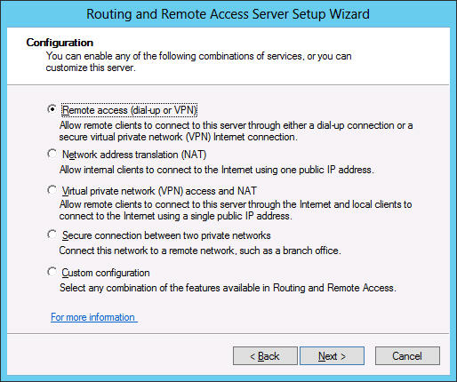
Deploying a DHCP relay agent

Slide 11
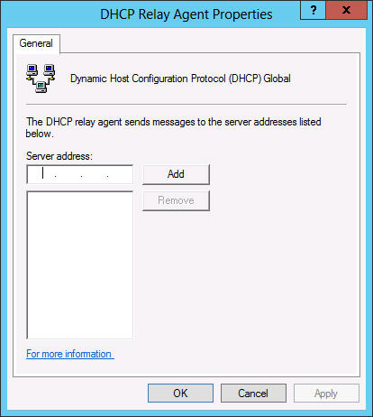
Deploying a DHCP relay agent

Slide 12
SERVER I
Task 5:
Configure WINDOWS SERVER 2012 as a DHCP Server.
Configure WINDOWS 7 or 8 as Client OS to obtain IP address automatically from DHCP Server.

